Slide 1
State Modeling
Event
-Event is noteworthy change in object state.
-Event is an occurrence at a point in time.
- Events are happening instantaneously with
regards to a time scale of an application.
Events can be
-causally unrelated (concurrent),
-precede each other,
-follow each other.
-Concurrent events can occur in any order.

Slide 2
Event Type
-Signal event
- Change event
Time event
Call event

Slide 3
Signal Event
-A signal event is event of sending or receiving
information.
-A signal is a one way message from one object to another.
-A signal represents an object that is dispatched (thrown) asynchronously by one object and then received (caught) by another.
-Exceptions are an example of a kind of signal.
-signals are modeled as stereotyped classes and the relationship between an operation and the events by using a dependency relationship, stereotyped as send

Slide 4
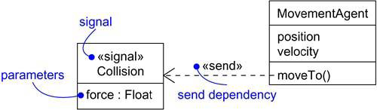

Slide 5
Time Event
-A time event is an event caused by the elapse of a
time interval or by matching an absolute time point.
-Expression is continuously tested,
- Whenever it changes from false to true, the event
happens
- UML notation for a change event (after or when
followed by expression that evaluates a condition)
when (date = January 1, 2000)
• after (10 seconds)

Slide 6
Change Event
A change event is an event that is caused by
satisfaction of a Boolean expression.
The condition must be checked often enough so that it seems continuos from the application perspective
UML notation for a change event (when followed by boolean expression)
when (room temperature < heating set point)
• when (room temperature > cooling set point)

Slide 7
Call Events
A call event represents the dispatch of an operation from one object to another.
A call event may trigger a state change in a state machine.
A call event, in general, is synchronous.

Slide 8
States
A state is an abstraction of the values and
links (association instances) of an object.
A state can be defined by a set of attribute
values and links to other objects.
In defining states, we ignore attributes that
do not affect the object behavior.
Objects have a finite number of possible
states.
Each object can only be in one state at a
time.

Slide 9
change state of object by:
-Creation/Termination operation,
- Access operation,
-Modification operation.

Slide 10
States and Events
There is a certain symmetry between events and states:
-Events represent points in time
- States represent intervals of time

Slide 11
Transitions and Conditions
Transition is an instantaneous change from one state to another.
The transition is fired upon change from the
source state to the target state.
A guard condition is boolean expression that
must be true for a transition to occur.

Slide 12
State Diagrams
-A class with more than one state has important
temporal behavior.
-State diagram is defined for one class of objects.
-All objects in a class execute state diagram for
that class, which represents their common
behavior.
- State model consists of multiple state diagrams.

Slide 13
A state machine diagram models the behavior of a single object, specifying the sequence of events that an object goes through during its lifetime in response to events.
A state diagram is used to model the dynamic behavior of a class in response to time and changing external stimuli.
referred to as State machines and State-chart Diagrams.

Slide 14
State diagram
Overview
Formally known as State Machine Diagrams
Events may result into state changes called as transitions
Event is considered to be instantaneous
Composite state
Used to simplify diagrams
May have substates as sequential or concurrent
May have transitions from substate
May remember history

Slide 15
There are a total of two types of state machine diagrams:
1)Behavioral state machine
It captures the behavior of an entity present in the system.
It is used to represent the specific implementation of an element.
The behavior of a system can be modelled using behavioral state machine diagrams.
2)Protocol state machine
These diagrams are used to capture the behavior of a protocol.
It represents how the state of protocol changes concerning the event. It also represents corresponding changes in the system.
They do not represent the specific implementation of an element.

Slide 16
State Diagram
Overview
Fundamental elements of state diagram are state and transitions
Figure shows the states of light
Lift switch
Off
On
Lower switch

Slide 17
State Diagram
State is the condition of being at a certain time
State can be passive quality such as ‘On’ and ‘Off ’ for the light object
A state can be an active quality, something that the object is doing [e.g. coffee brewing]
Symbol for state is a rounded corner rectangle

Slide 18
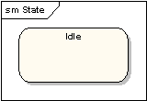
States - A state is denoted by a round-cornered rectangle with the name of the state written inside it.

Slide 19
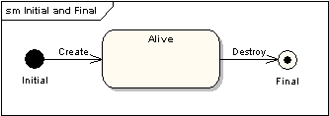
Initial and Final States - The initial state is denoted by a filled black circle and may be labeled with a name.
The final state is denoted by a circle with a dot inside and may also be labeled with a name.

Slide 20
State Diagram
Overview
This state diagram shows initial pseudo state and final state
pending
approve
processing
confirm
completed
Initial state
Final state

Slide 21
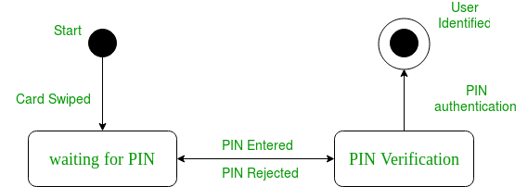

Slide 22
State Diagram
Transitions
A transition shown as an arrow represents a change of state from source state to destination/target state. The transition description written along the arrow describes the circumstances causing the state change to occur
The complete signature of transition is
trigger [guard]/transition behavior

Slide 23
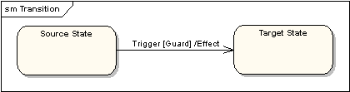
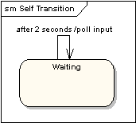
Transitions - Transitions from one state to the next are denoted by lines with arrowheads. A transition may have a trigger, a guard and an effect.
Self-Transitions - A state can have a transition that returns to itself, as in the following diagram.

Slide 24
"Trigger" is the cause of the transition, which could be a signal, an event, a change in some condition.
"Guard" is a condition which must be true in order for the trigger to cause the transition.
"Effect" is an action which will be invoked directly on the object that owns the state machine as a result of the transition.

Slide 25
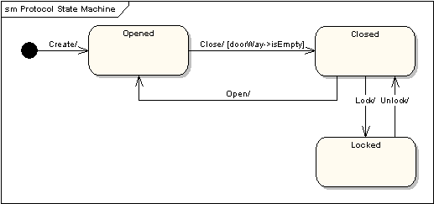

Slide 26
State Diagram
Transition examples
The most common type of transition features a trigger
Object:-CD player
Playing
Do/read disc
stopped
Press stop

Slide 27
State Diagram
Transition examples
A guard will block a transition if it evaluates to false
Playing
Do/read disc
Press play [disc in tray]/ play
stopped

Slide 28
State Diagram
In the following example state change has occurred due to completion of internal behavior
Playing
Do/read disc
stopped

Slide 29
State diagram
Guards can be used to model a choice between paths
Ex:- Self transition
[another disc]/change disc
Playing
Do/read disc
[No more discs]
stopped

Slide 30
State Diagram
States in software
Object:- Order
Place order
placed
entered
Take order
Fill order
delivered
filled
Deliver order

Slide 31
Advanced state description
Show the behavioral details in a state by showing activities within a rectangle.
Name
Internal Activity
Internal Transition
Labels
Entry: Trigger when state is entered
Exit: Trigger when leaving state
Do: execute as long as state is active

Slide 32
State Diagram
One can show the behavioral details in a state by showing those activities within a rectangle. This is called as advanced state description
faxing
Idle
Entry/key in the fax number
Exit/complete transmission
Do/scan
Do/send data
Do/advance paper
Entry/fax complete
Exit/key in fax number
Do/show date
Do/show time

Slide 33
State diagram
An internal transition models a reaction while staying in the same state
Brewing
Do/brewing coffee
Coffee pot removed/suspend
Coffee pot replaced/resume

Slide 34
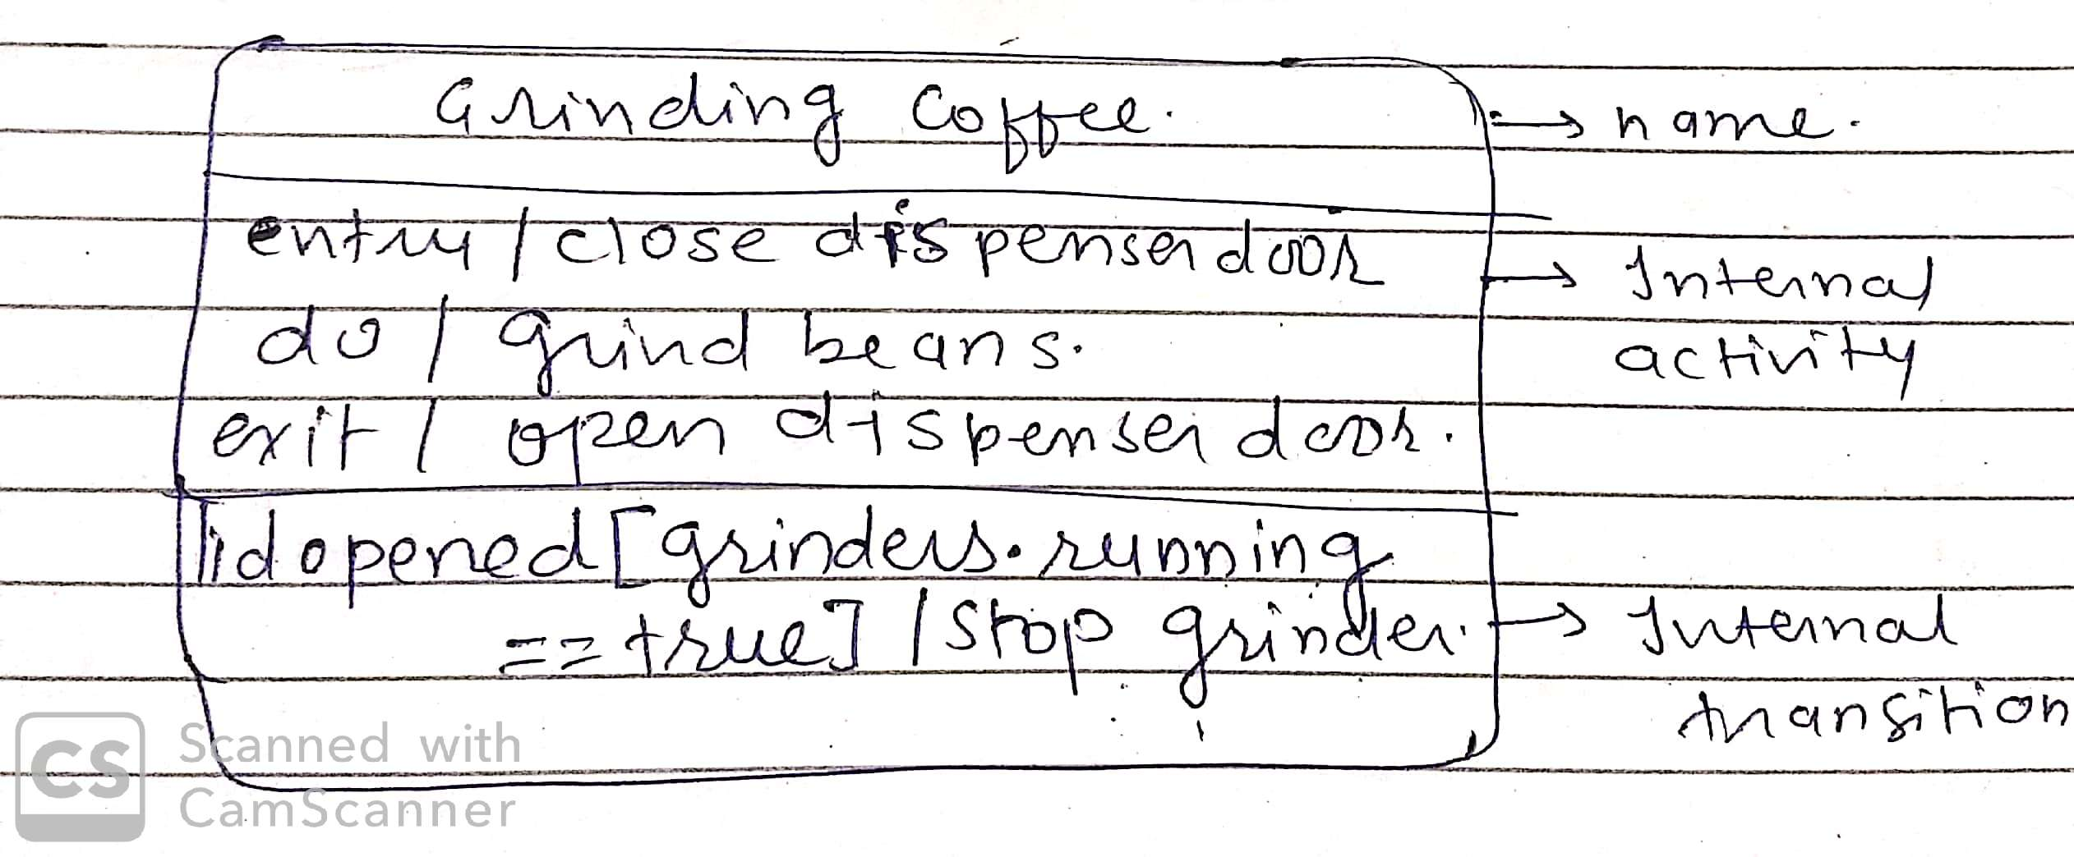

Slide 35
State Diagram
Composite state
Sequential substates
Dialing
digit(n)
Start
Entry/start dialtone
Exit/stop dialtone
PartialDial
Entry/number.append(n)
Exit/stop dialtone
[number.isComplete]
digit(n)

Slide 36
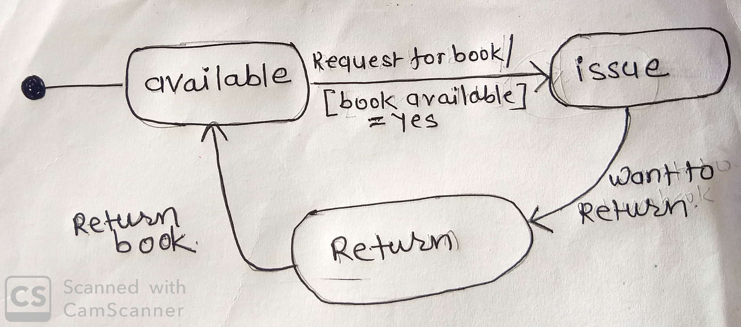
Object: Book

Slide 37
Issue
Entry/ Request for book
Exit /Return book by member

Slide 38
Object: Librarian
Login
Entry / Pass and ID is correct
Do/ issue book
/Take return
/calculate fine
Request from member
Click on logout
Logout
No Request from member
Request from member

Slide 39
Object: Librarian
Login
Entry / Pass and ID is correct
Do/ issue book
/Take return
/calculate fine
Request from member
Click on logout
Logout
No Request from member

Slide 40
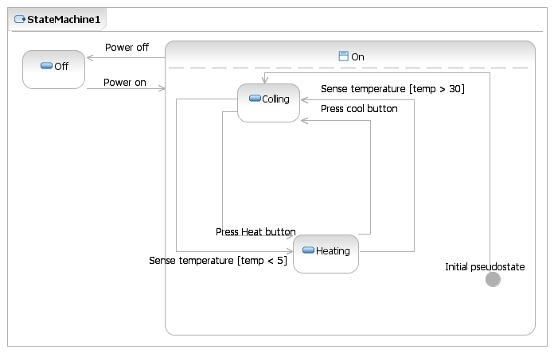
State Diagram

Slide 41
Type of States
Simple state
-no sub states
Composite state
-one or more substates
- A composite state with two or more
substates is called an orthogonal state.
Submachine state
-sub states
-reuse
History state

Slide 42
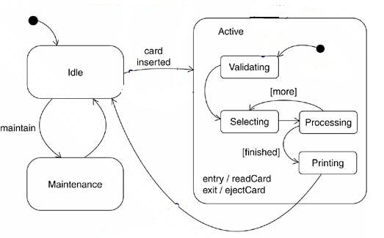
Composite state Example

Slide 43
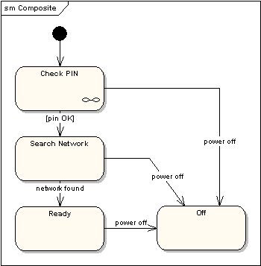
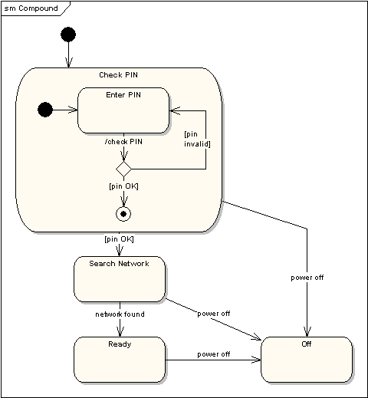
Sub Machine State

Slide 44
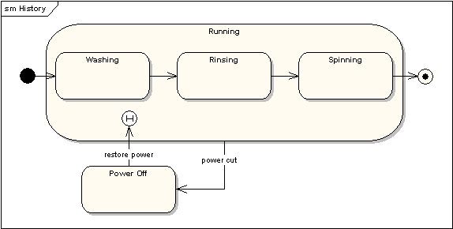
History state

Slide 45
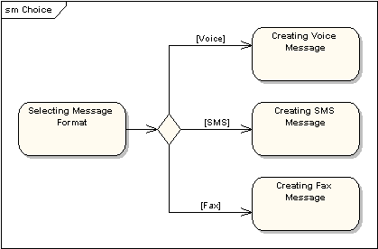
State Machine Diagrams
Choice Pseudo-State - A choice pseudo-state is shown as a diamond with one transition arriving and two or more transitions leaving.

Slide 46
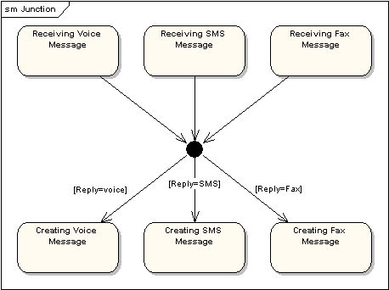
State Machine Diagrams
Junction Pseudo-State - Junction pseudo-states are used to chain together multiple transitions. A single junction can have one or more incoming, and one or more outgoing, transitions; a guard can be applied to each transition.

Slide 47
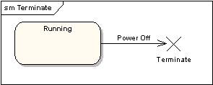
State Machine Diagrams
Terminate Pseudo-State - Entering a terminate pseudo-state indicates that the lifeline of the state machine has ended. A terminate pseudo-state is notated as a cross.
History States - A history state is used to remember the previous state of a state machine when it was interrupted. The following diagram illustrates the use of history states. The example is a state machine belonging to a washing machine.
Notes:
In this state machine, when a washing machine is running, it will progress from "Washing" through "Rinsing" to "Spinning". If there is a power cut, the washing machine will stop running and will go to the "Power Off" state. Then when the power is restored, the Running state is entered at the "History State" symbol meaning that it should resume where it last left-off.

Slide 48
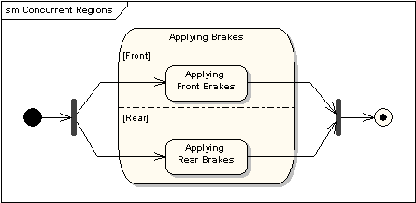
State Machine Diagrams
Concurrent Regions - A state may be divided into regions containing sub-states that exist and execute concurrently. The example below shows that within the state "Applying Brakes", the front and rear brakes will be operating simultaneously and independently.

Slide 49
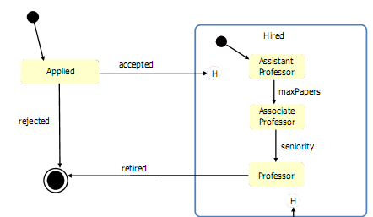

Slide 50
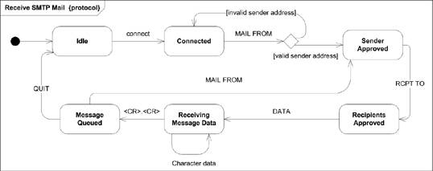
Protocol State

Slide 51
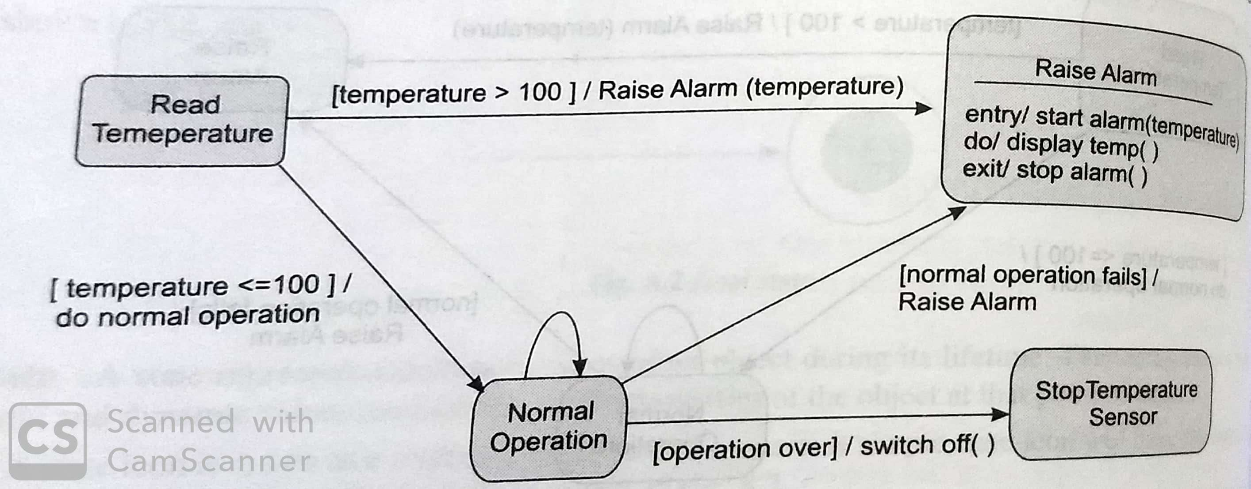

Slide 52
Timing Diagrams
In UML, the timing diagrams are a part of Interaction diagrams that do not incorporate similar notations as that of sequence and collaboration diagram.
Focus on the specific timing of message sent between object
It consists of a graph or waveform that depicts the state of a lifeline at a specific point of time.

Slide 53
Timing Diagrams
UML timing diagrams are used to display the change in state or value of one or more elements over time.
It can also show the interaction between timed events and the time and duration constraints that govern them.
focus is on timing constraints.

Slide 54
Following are some important key points of a timing diagram:
It emphasizes at that particular time when the message has been sent among objects.
It explains the time processing of an object in detail.
It is employed with distributed and embedded systems.
It also explains how an object undergoes changes in its form throughout its lifeline.
As the lifelines are named on the left side of an edge, the timing diagrams are read from left to right.
It depicts a graphical representation of states of a lifeline per unit time.

Slide 55
timing diagram elements
Lifeline
Lifeline is a named element which represents an individual participant in the interaction.
As the name suggests, the lifeline portrays an individual element in the interaction.
It represents a single entity, which is a part of the interaction.
It is represented by the classifier's name that it depicts. A lifeline can be placed within a "swimlane" or a diagram frame.

Slide 56

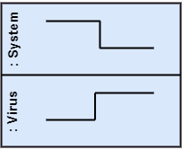
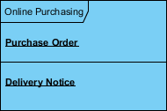
Multiple lifelines may be stacked within the same frame to model the interaction between them.

Slide 57
State or Condition Timeline
A state or condition timeline represents the set of valid states and time.
Timing diagram could show states of the participating classifier or attribute, or some testable conditions, such as a discrete or enumerable value of an attribute.

Slide 58
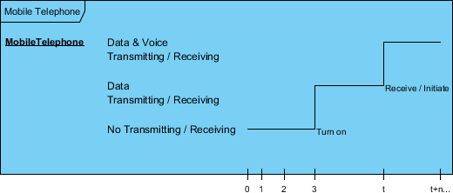
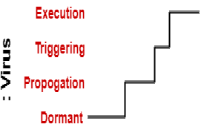
Timeline showing the change in the state of virus between dormant, Propagation, Triggering, Execution

Slide 59
Multiple Compartments
It is possible to stack several life lines of different objects in the same timing diagram.
One life line above the other.
Messages sent from one object to another can be depicted using simple arrows.
The start and the end points of each arrow indicate when each message was sent and when it was received.

Slide 60
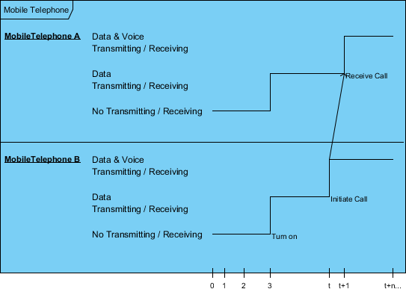

Slide 61
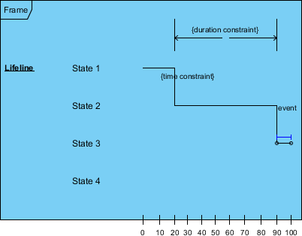
State Lifeline
A state lifeline shows the change of state of an item over time.
The X-axis displays elapsed time in whatever units are chosen while the Y-axis is labeled with a given list of states. A state lifeline is shown below:

Slide 62
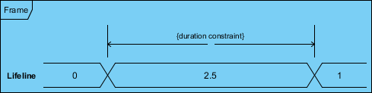
Value Lifeline
A value lifeline shows the change of value of an item over time.
The X-axis displays elapsed time in whatever units are chosen, the same as for the state lifeline.
The value is shown between the pair of horizontal lines which crosses over at each change in value.

Slide 63
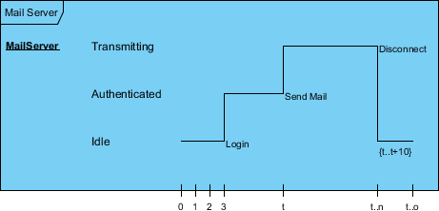
Timeline and Constraints
We can use the length of a timeline to indicate how long the object remains in a particular state by reading it from left to right.

Slide 64
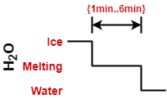
Duration Constraint
The duration constraint is a constraint of an interval, which refers to duration interval. It is used to determine if the constraint is satisfied for a duration or not.
Ice should melt into the water in 1 to 6 mins.

Slide 65
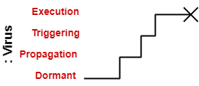
Destruction Occurrence
The destruction occurrence refers to the occurrence of a message that represents the destruction of an instance is defined by a lifeline.

Slide 66
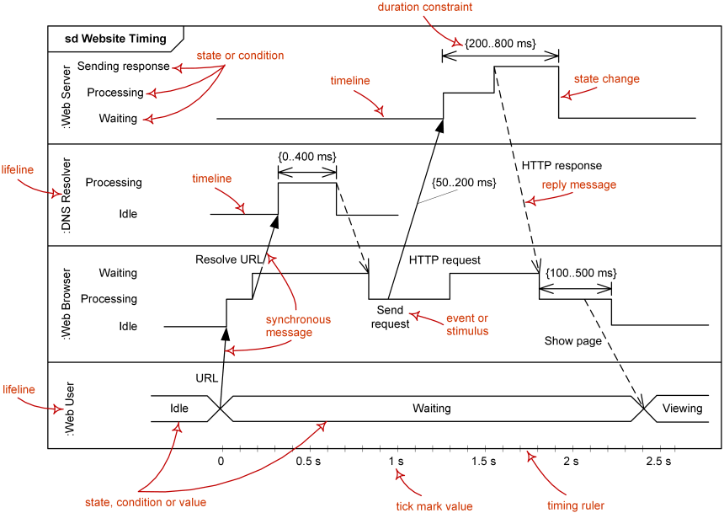

Slide 67
